Slide 1
Payments / Monetization Analyst
Module: Analyzing Business Problems
Sprint: Payments / Monetization Analyst
Part 3: Graded task

Slide 2

Investigation
How the freight price is related to the customer satisfaction.
What does the price of freight depend on?

Slide 3


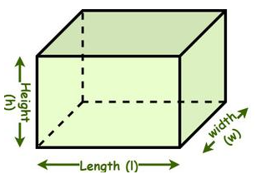
Do we have correlation between:
Freight price and product price?
Freight price and product weight (kg)?
Freight price and product volume (cbm)?

Slide 4
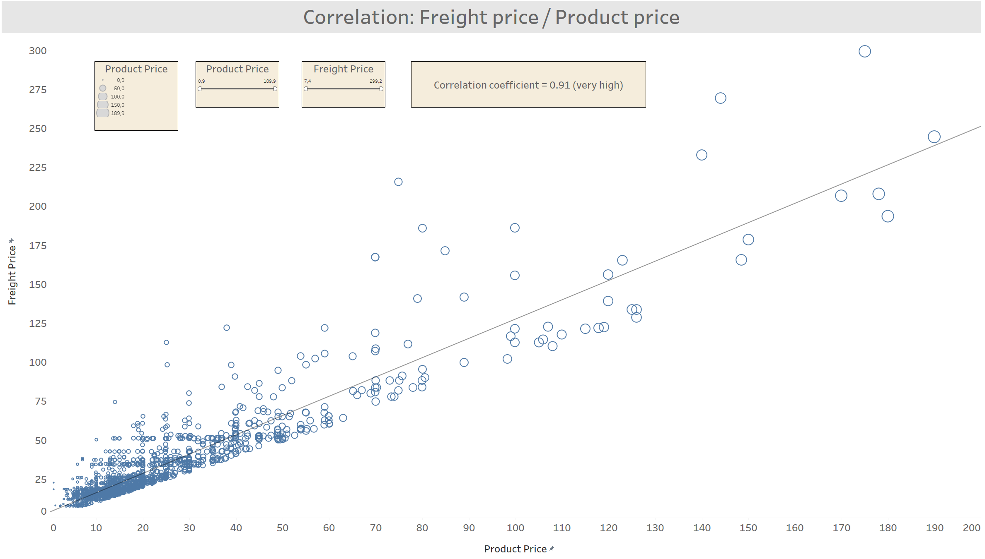

Slide 5
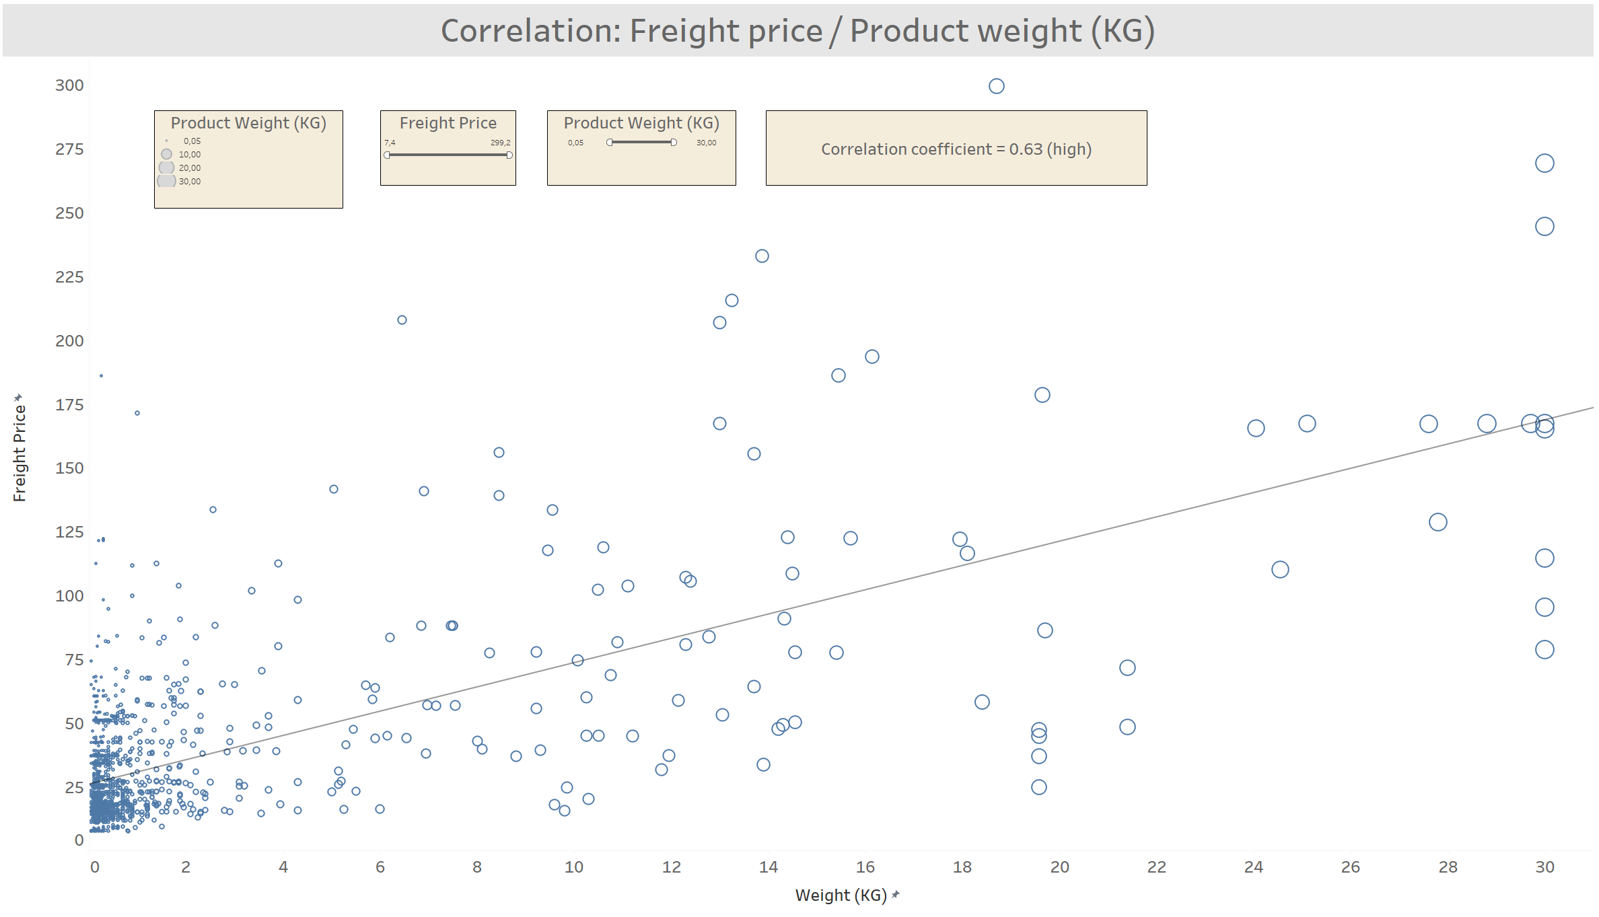

Slide 6
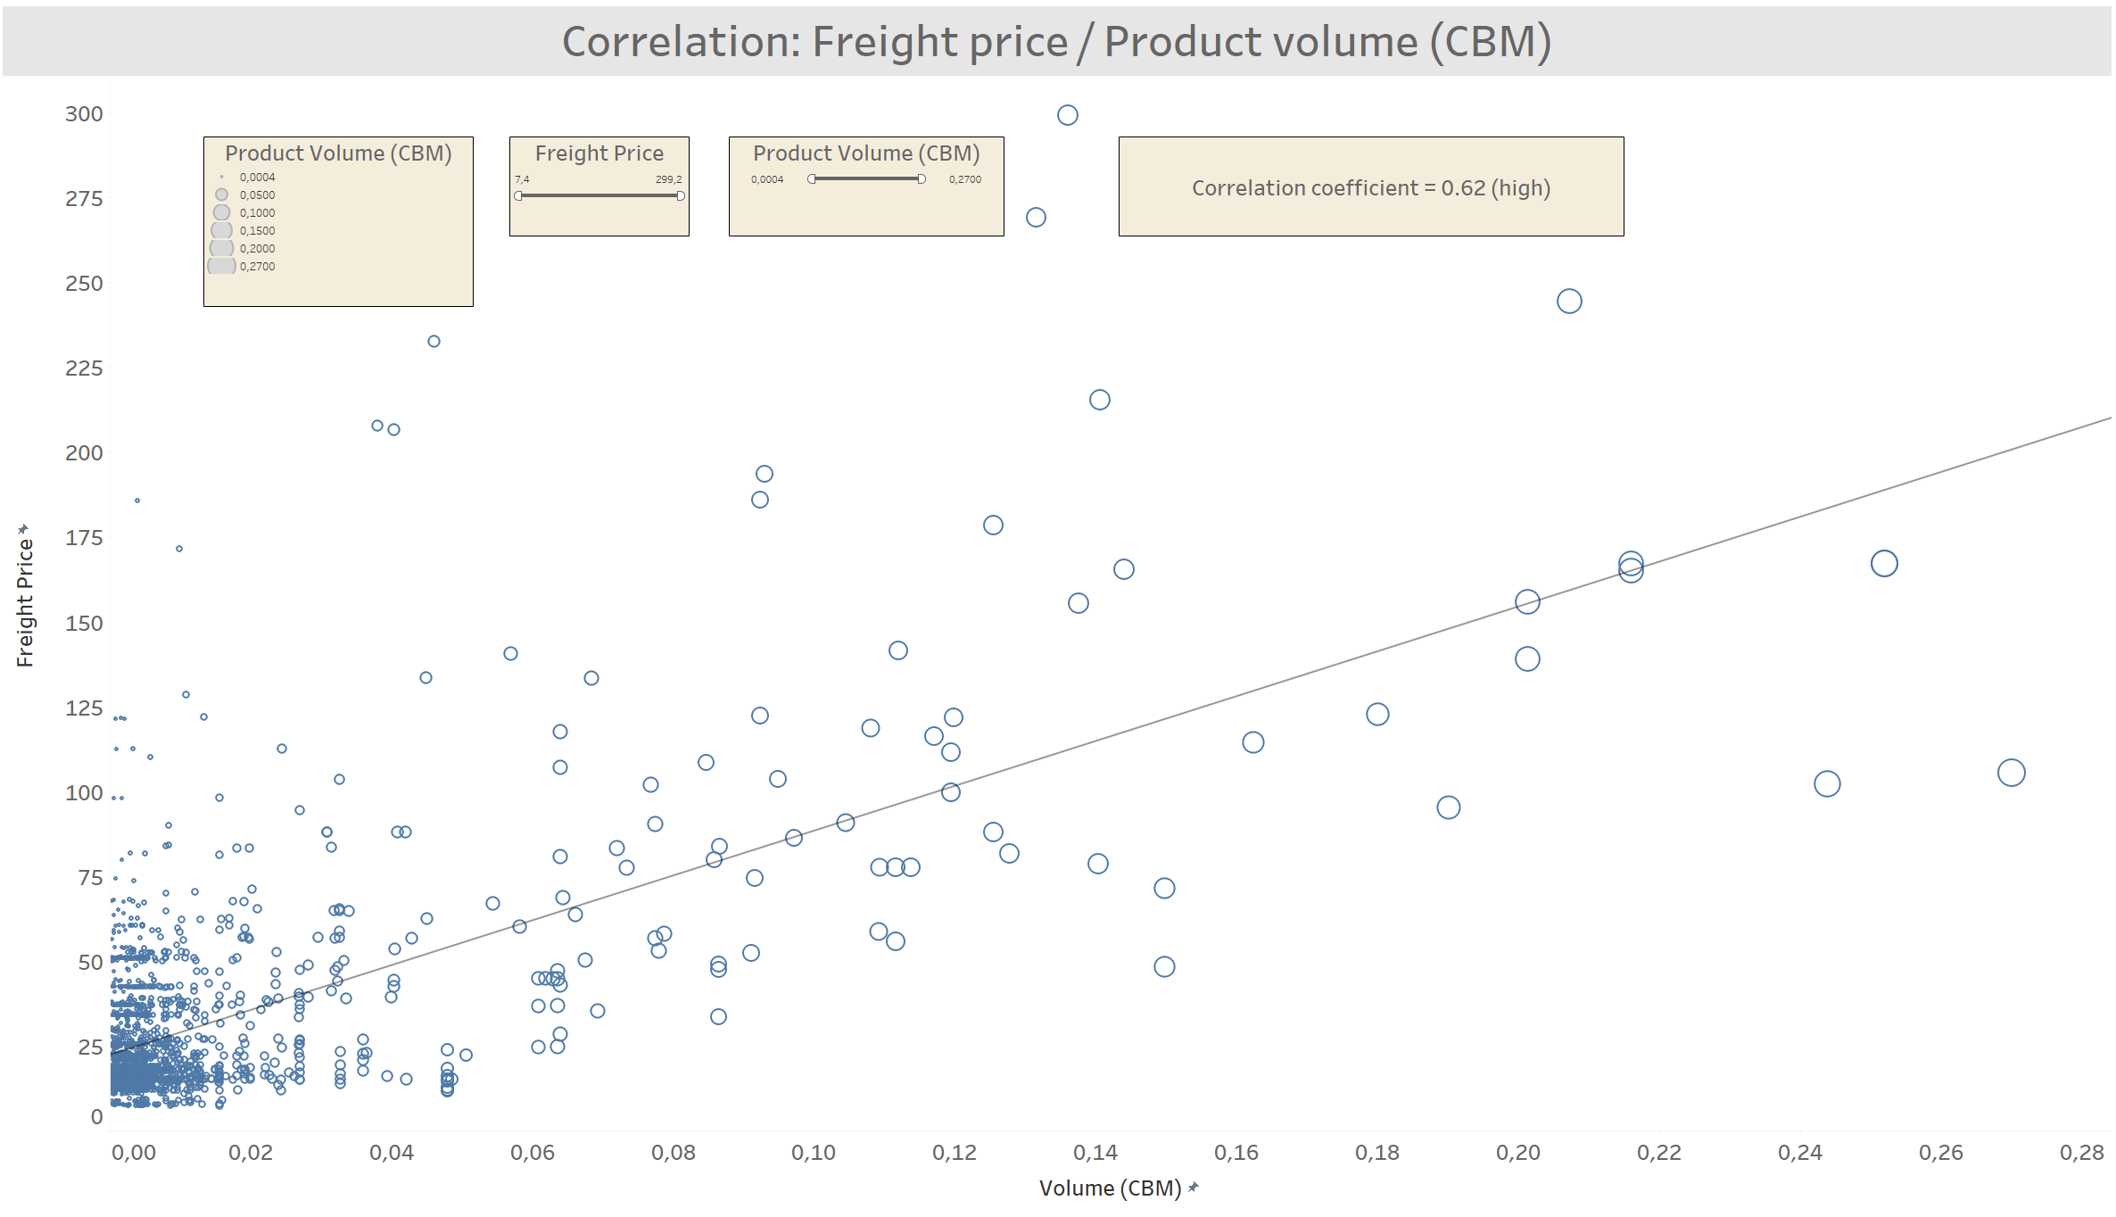

Slide 7
Summary of three charts
Freight price / Product price (correlation coefficient = 0,91)
Freight price / Product weight (correlation coefficient = 0,63)
Freight price / Product volume (correlation coefficient = 0,62)
These three factors (product price, weight, volume) are closely related (correlate)
with freight price and can influence customers satisfaction which is measured on
a scale of 1 to 5.

Slide 8

How these correlations influence customers review score (from 1 to 5)?
When the freight price compared to the product price is between:
(1st bin) from 0% to 10%
(2nd bin) from 10% to 15%
(3rd bin) from 15% to 20%
(4th bin) from 20% to 25%
(5th bin) from 25% to 30%
(6th bin) from 30% to 40%
(7th bin) from 40% to 50 %
(8th bin) from 50% to 70%
(9th bin) from 70% to 100%
(10th bin) from 100% to max%

Slide 9
Examples:
(Freight price 2$ / Product price 20$) * 100 = 10% (the order falls into 1st bin (from 0% to 10%)
(Freight price 20$ / Product price 80$) * 100 = 25% (the order falls into 4th bin (from 20% to 25%)
(Freight price 35$ / Product price 120$) * 100 = 29% (the order falls into 5th bin (from 25% to 30%)

Slide 10
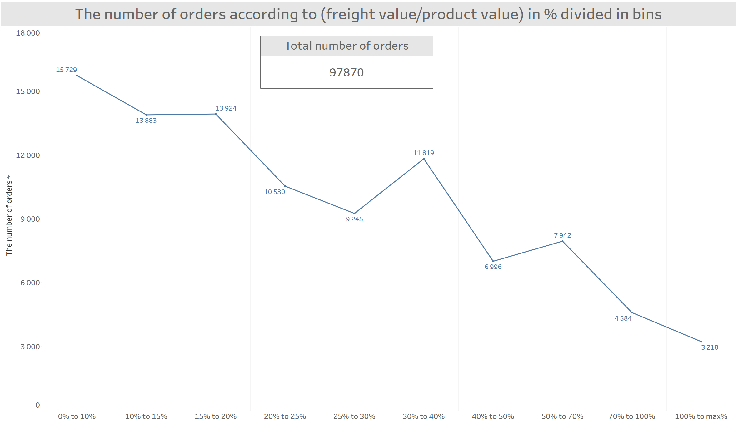

Slide 11
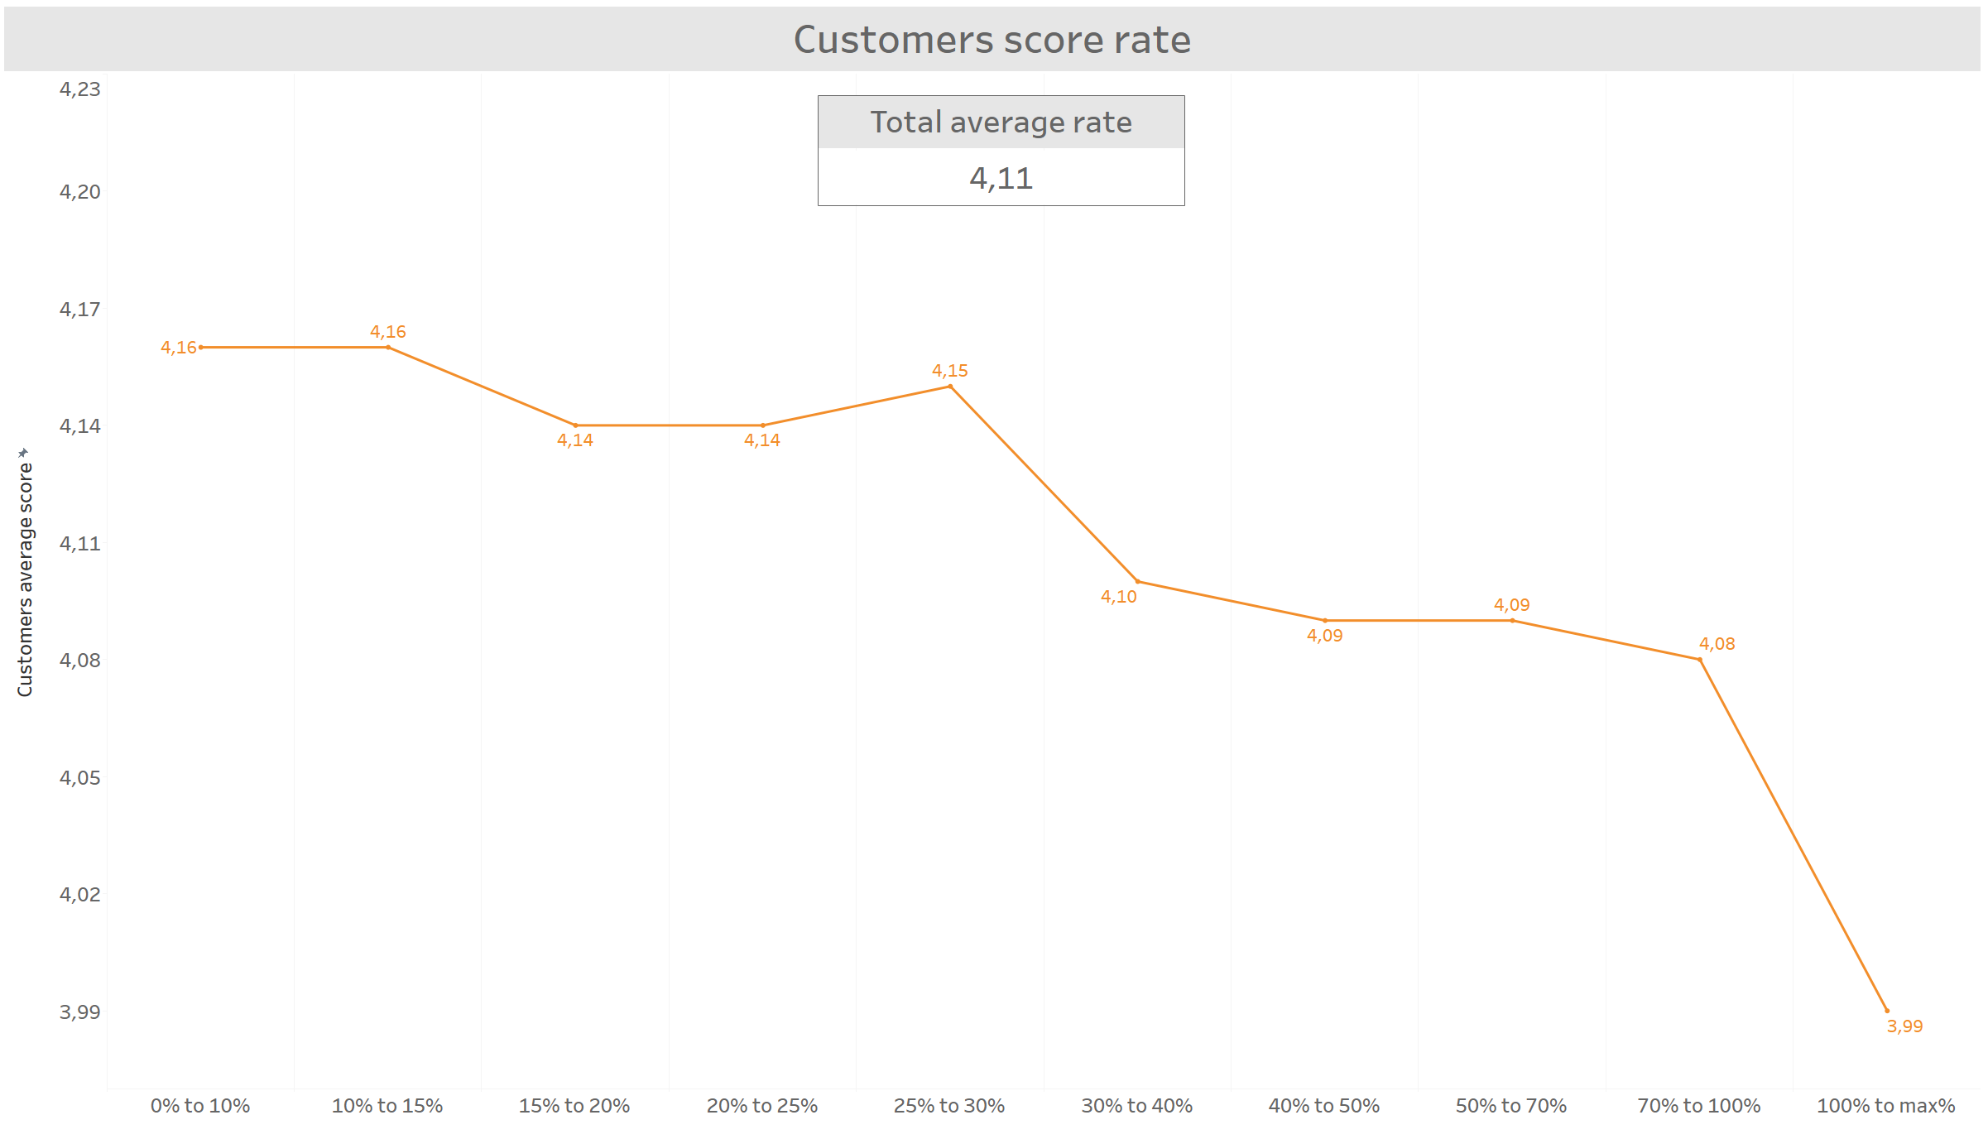

Slide 12
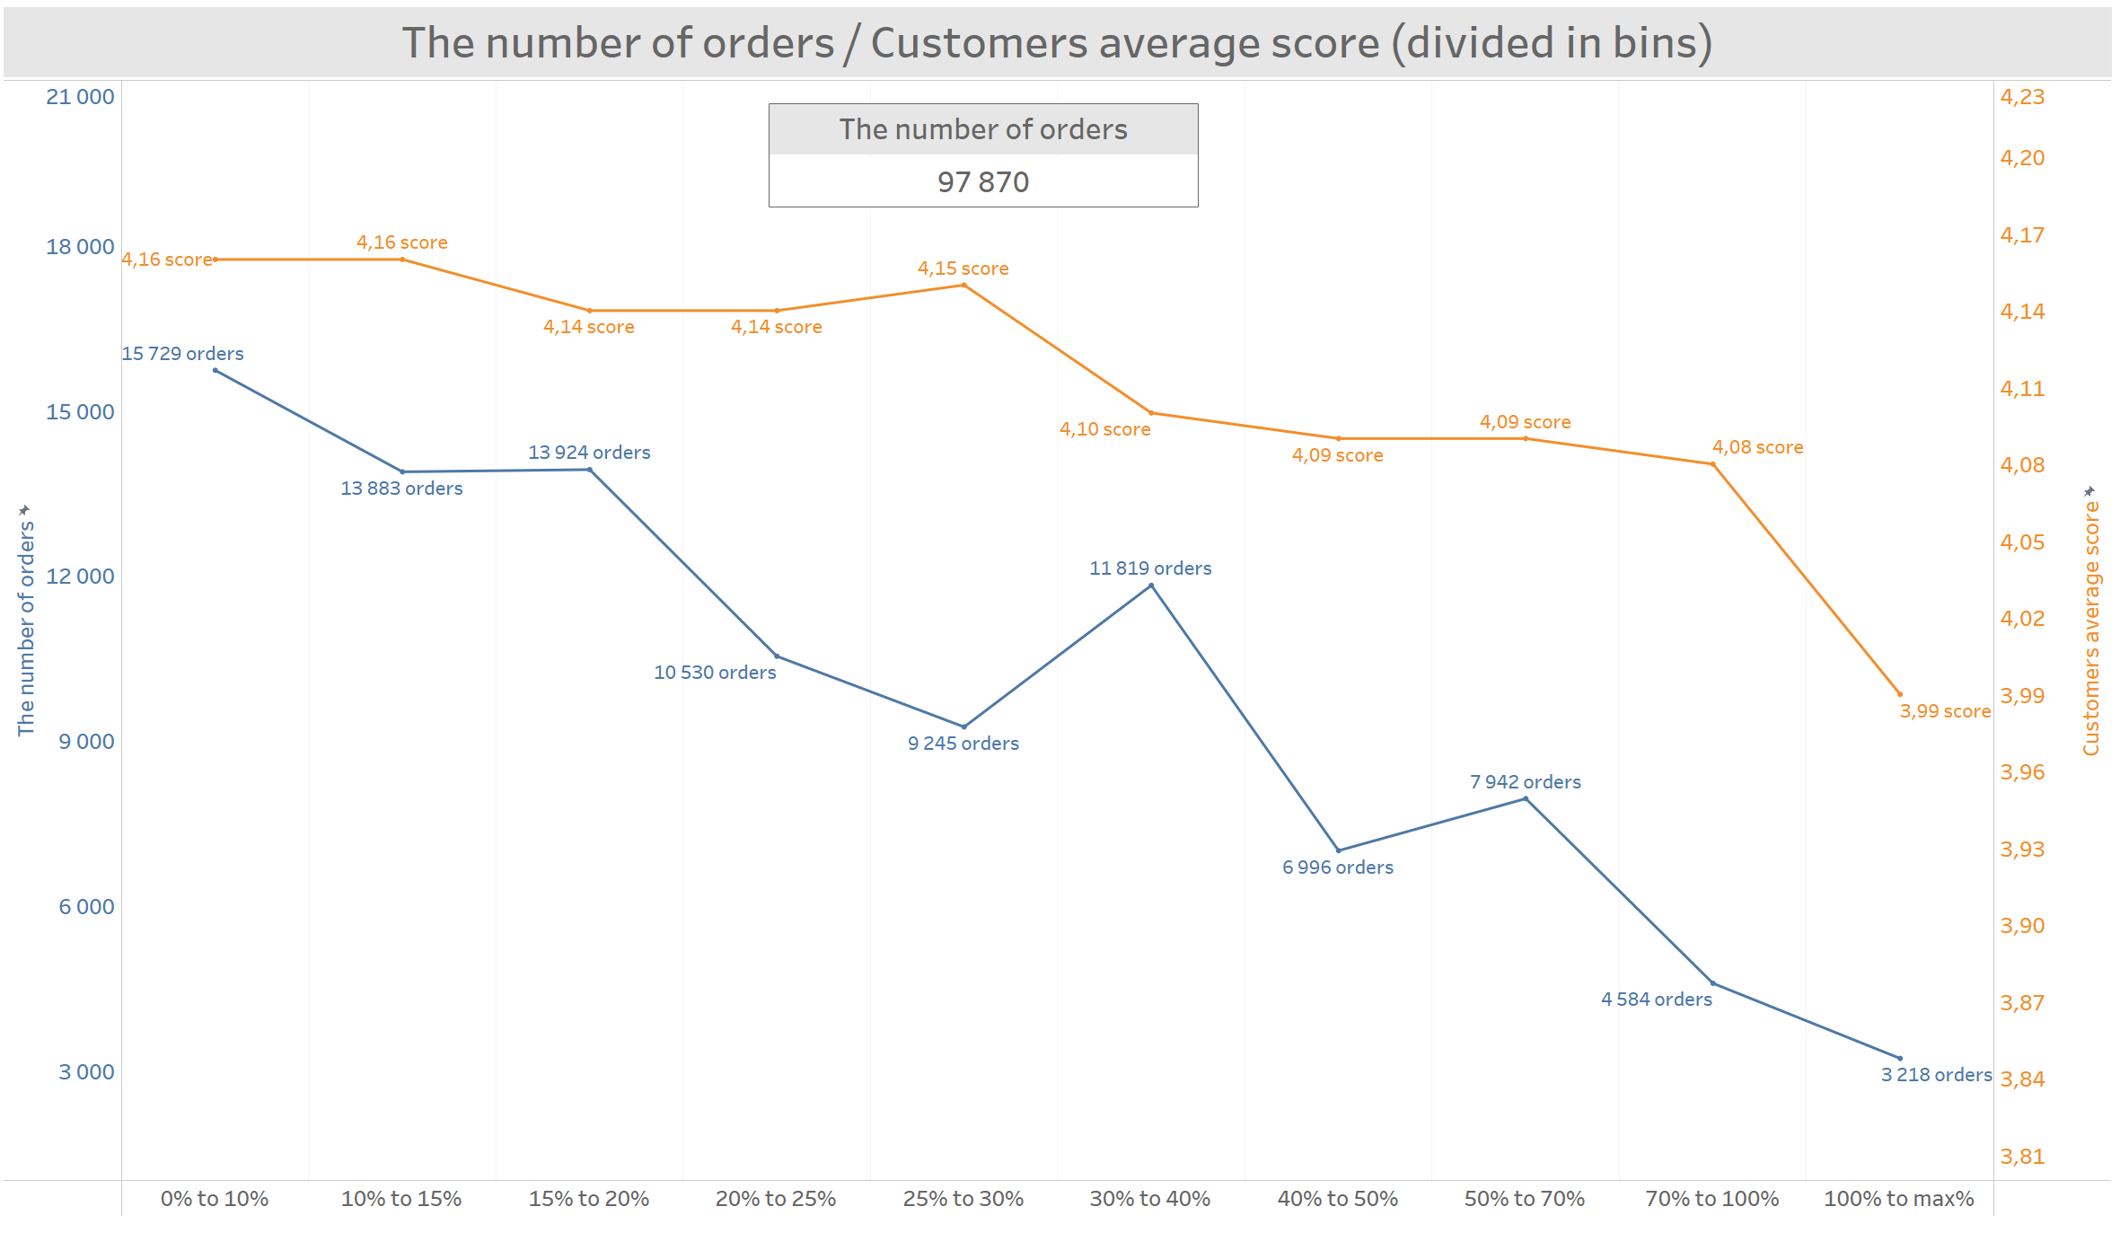

Slide 13
Summary / Insights
The first three charts show that we have a strong correlation between freight price and product price, weight, and volume. The freight price increases when all three of these factors increase.
The score chart shows that when the freight price goes up, the customer satisfaction score slightly goes down. We can see that customers don't like having to pay more for freight, as customer satisfaction decreases.
The most significant decline is observed when the freight price is 30% or more compared to the product price. The customer satisfaction score decreases from 4.15 to 4.10.
The second significant decline is seen when the freight is 100% or more. The score rate is 3.99.

Slide 14
Suggestions
As we see customer satisfaction decreasing, starting at a 30% freight price, we can:
Consider the weight of the packages. Maybe it is possible to use lighter boxes and packing materials.
Consider the size of the packages. Maybe it is possible to pack them into smaller boxes.
Consider the possibility that customers would have the option to order delivery using their own courier or transportation company.
Consider the possibility that customers would have the option to pick up the product themselves from the store or warehouse.
Check other transportation companies' price lists for deliveries, especially for the larger packages where we have a 30% or more increase in cost.

